Slide 1
Case study | Software developer – Big Data & Analytics
Houssem Ben Lahmar

Slide 2
Problem
A company X has released a product P.
This product requires initially a registration of user.
The user has to provide some personnel information:
Name
Birthday
Address
Etc…
This product P is used worldwide. This means that there are new registered users every day, every hour and every second.
It is challenging/hard to keep tracking the usage of the product P in real time.

Slide 3
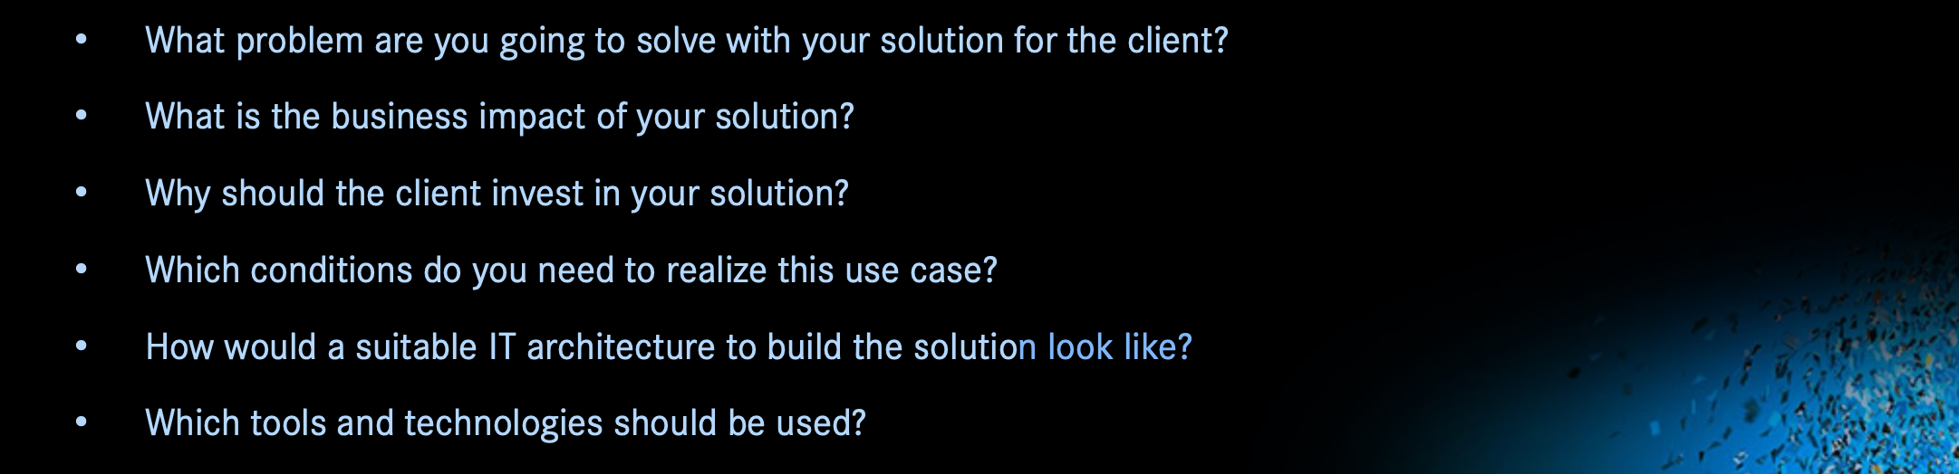
Outline

Slide 4
Goal & business impact
Gain insight about the usage of your product
Business impact:
Track/understand the usage of your product in real time
Get insight about the popularity of the product
Worldwide?
Or in a specific country.

Slide 5
Why should client invest in the application?
Two gains:
Storage of raw data in real time
Processing/analysing data in real time
Examples of analytical questions to reply:
Evolution of new user's number
Number of users per country
From which country people are more registering in the product P in the last few minutes, few days or few months?
Other statistics

Slide 6
Requirements
Which conditions do you need the use case?
An API that collects in real time information about new registered users.

Slide 7
Our use case
We are using “Randomuser” API
https://randomuser.me/api/?inc=name,gender,nat,location&noinfo
RandomUser API

Slide 8
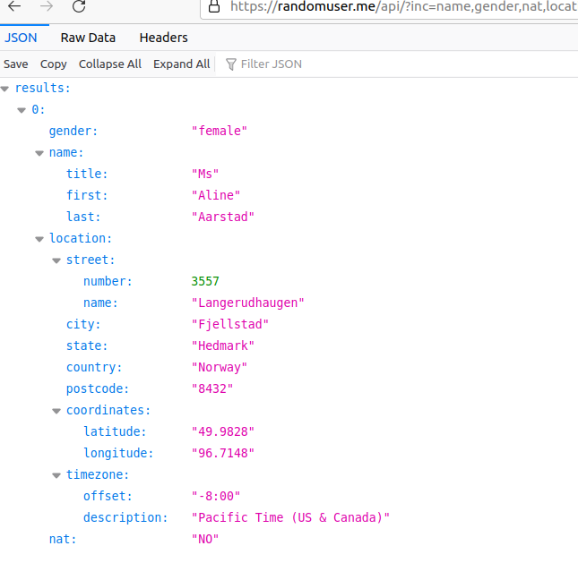
Content of raw data

Slide 9


Architecture
Product P
archiving
Capture data in real time
Data processing
RandomUser API
Query the data
Dashboarding

Slide 10
Implementation
archiving
processing
RandomUser API
Dashboarding

Slide 11
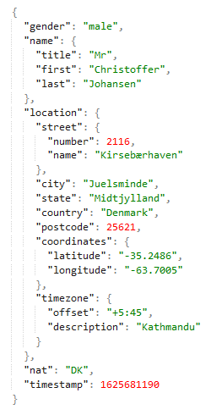
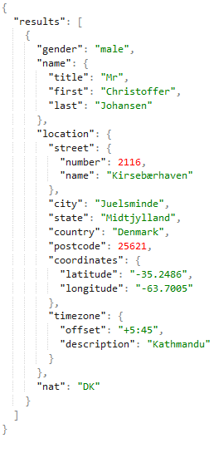
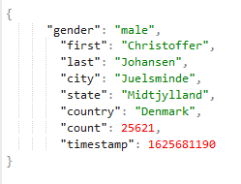
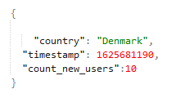
Data flow
Product P
archiving
Data processing
Capture data in real time
RandomUser API
Query the data

Slide 12

Demo

Slide 13
Improvements to do/problem to solve (1/2)
Conformity with GDPR: anonymization of the data
Improvement of data quality:
e.g., by removal of incomplete data
E.g., entity resolution
Data governance: collecting data provenance: e.g., using delta lake format recently proposed in Spark

Slide 14
Improvements to do/problem to solve (2/2)
Classify/characterize set of users:
For example, those having the same interest
For example, same types of users
Detect malicious users

